Slide 1


Capstone Project: Progress Report
Elisabeth Webb, Eric Wu, Carla Fera,
Elizabeth Hyde, Vincent Chen, Ben DeLeon
Mentor: Zhen (Richard) Tang
Notes:
Sorry give a minute

Slide 2
Agenda
Introduction
Summary of Projects
RPA
RMDS + Future Data Lab
Summary of Learning Outcomes
Review of Learning Outcomes
Theory of NLP
From Word2Vec to Transformers
NLP Model Implementation and Demonstration
NLP + Downstream ML Tasks
Data Preparation
Data Collection

Slide 3

Introduction
Summary of Projects and Learning Outcomes

Slide 4

RPA Project
Question:
How does the socioeconomic environment, specifically uncertainties in the current moment, influence consumers’ pursuit of different values?
Solution:
NLP on user-generated-content (UGC)

Slide 5
RPA Project: Methodological Approach
NLP Model
Neural Network
Time Series Analysis
Raw Textual Data
Encoded Texts: Numerical Representation
Quantified Attributes
Dynamics of Customer Value Focus
(Manual) Coding Customer Values
Outcome
Covered Steps
Method
Data / Metrics
Notes:
Started manual coding, all technical preparation is done.

Slide 6

RMDS Project
Question:
How to quantify the business environments of business establishments?
Solution:
From supply side: co-location index with other businesses
From demand side: local-specific customer preferences

Slide 7
RMDS Project: Methodological Approach
Wasserstein Distance
Data Integration
NLP
Business Establishment GIS Data
Co-location Index
Quantified Business Environment
Quantified Consumer Preference
Location-specific UGC
Outcome
(Manual) Coding Customer Preference
Covered Steps
Method
Data / Metrics
Notes:
Data collection on user-generated content (UGC) and on location of business establishment are done
Regrading method: the model and code to extract customer preference from UGC is done, but still lacks of manual coding on those preference

Slide 8
Summary of Learning Outcomes
NLP
Word Embedding
RNN
Attention
Self-attention and Transformer
Transformer-based NLP model
Neural Network
Build Neural Network on top of NLP model
PyTorch Implementation

Slide 9

Review of Learning Outcomes
Knowledge and Skill Preparation for Capstone Projects
Notes:
Ben: We studied the theory of NLP in summer session 1, as it will be used in our capstone projects. This strong understanding of theory will help us not only in the capstone project, but will be useful in our future jobs and be a differentiating factor in the job market.

Slide 10

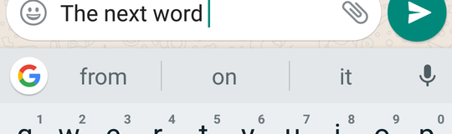
Purpose
Natural Language Processing (NLP): interaction between computers and human language
Read, decipher, understand languages
Rapidly advancing in past 10 years
Notes:
Ben
NLP has a long history, but in recent years it achieved even significant progresses. We want to let the audience how we make machines understand and process our human’s natural language.
Key milestones of NLP have occurred in the last 10 years and continue to advance at a rapid rate
NLP plays a critical role in supporting machine-human interactions
To do so, we give them a brief introduction on the key milestones of NLP (note that all the key advancements are in less than 10 years; how fast-developing and flourish this area), and let them know how each improvement make a difference: word2vec (machine can see the semantic meanings of words from the word embeddings/numerical vectors representing words, and thus mathematical operation can be done with words), attention (machine can now realize the context; put words into their contexts to understand them), self-attention(much efficient way to do attention), transformer (many layers of self-attention with multiple-heads: machine can understand the text from different perspectives and synthesize the meanings).
Lastly, not only NLP is developing fast, it is equally fast at democratizing: common users like us can easily utilize the newly developed methods/models of NLP once we understand the theory above (thanks to companies like Google, Open AI, Huggingface, etc. that make the models available to us). In the pantheon of transformer-based NLP models, we focus on BERT, because: BERT to NLP is ImageNet to computer vision.

Slide 11
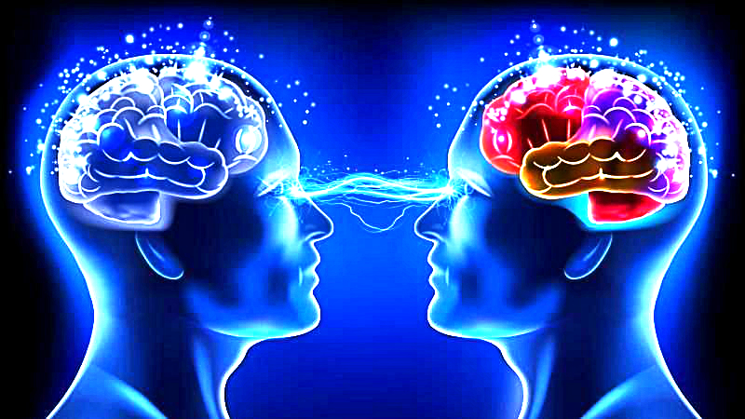
Milestones of NLP
Self-Attention and Transformers (Paper)
NLP models are capable to pay attention to contexts in conducting various NLP tasks
2013
2018
2017
Word2Vec(Paper)
Trained vector representations of words. Semantic meaning is embedded in the vector representations
BERT (Paper)
A transformer-based NLP model. The first large scale and transferable pre-trained model that could encode texts with their textual background--the ImageNet moment of NLP
Notes:
Ben
Generate a milestones of modern NLP: from word2vec (2013)to self-attention (2018) to BERT (2018), this three elements are enough
Let them know that our learning approch of NLP is pretty modern: we start from 2013!
Image → see→ fast
Text → read → hard/slow → transfemers → NLP

Slide 12
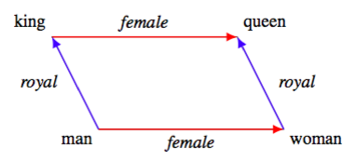
Word Embedding
Problem: Textual data needs numeric representation for ML
Solution: Extract information out of the text and convert it into numbers
Word Embeddings vector of numbers that represent meanings of text
Used to do math, for example (Word2Vec):
king - man + woman = queen
Notes:
Ben
Numerical representations of textual data
Why? ML and Deep Learning cannot process plain text in its raw form
ML + Deep Learning needs numbers, many data comes in text.
Solution: Extract information out of text and convert it into numbers
Word embeddings map a word using a dictionary to a vector
where words that have similar meanings have similar representations.
ID are semantic meaning king queen man woman

Slide 13
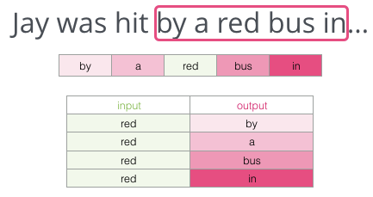

Word2Vec
An efficient method to generate a word embedding
2 Architectures:
Skip-gram: the representation of the target word is used to predict surrounding words
Works well with small amount of data and rare words or phrases
CBOW: the representations of the surrounding words are combined to predict the target word
Trains faster and slightly better accuracy for frequent words
Notes:
Ben
https://www.google.com/url?sa=i&url=https%3A%2F%2Fwww.thinkinfi.com%2F2019%2F08%2Fskipgram-explained.html&psig=AOvVaw2ib5W2VyzndJnEL4bLBy_T&ust=1594422931915000&source=images&cd=vfe&ved=0CA0QjhxqFwoTCNCRwL2mweoCFQAAAAAdAAAAABA8
https://www.google.com/url?sa=i&url=https%3A%2F%2Fwww.thinkinfi.com%2F2019%2F06%2Fsingle-word-cbow.html&psig=AOvVaw2ib5W2VyzndJnEL4bLBy_T&ust=1594422931915000&source=images&cd=vfe&ved=0CA0QjhxqFwoTCNCRwL2mweoCFQAAAAAdAAAAABBB
Resources: http://jalammar.github.io/illustrated-word2vec/
https://web.stanford.edu/class/cs224n/slides/cs224n-2020-lecture01-wordvecs1.pdf
Example that helps you illustrate your points
Original paper: http://papers.nips.cc/paper/5021-distributed-representations-of-words-and-phrases-and [2013]

Slide 14
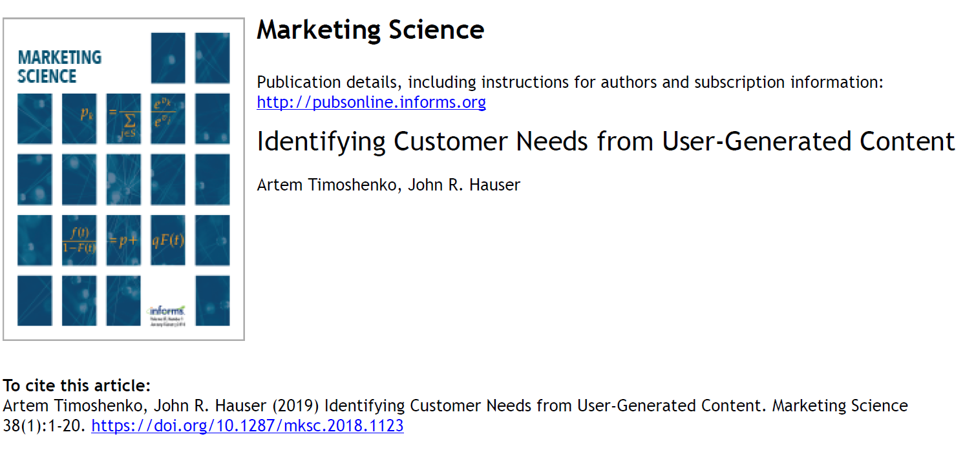
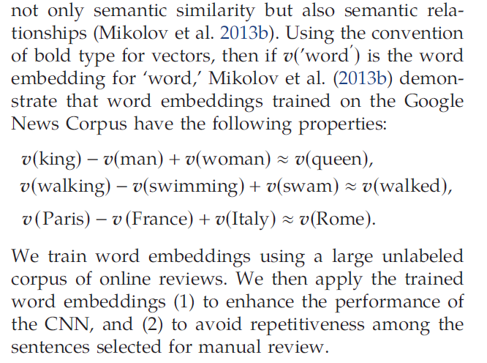
Implication of Word2Vec
Original word2vec papers
Notes:
Tell them that word2vec are still used a lot in business area, like this paper on marketing science (2019). Marketing science is the top journal in business area.
And in this paper, authors use amazon review to extract product improvements, they show that their automatic NLP approach is at least as traditional customer focus group and expert review transcript approach in terms of useful info extracted.
In the paper, the word embedding system they use is word2vec. By the way, we could replicate their method through learning summer 1.
Took the reviews and asked machine to find most important things that customers are looking for and that was more efficient than hiring a specialist to look through user generated content
-machine is faster, more efficient

Slide 15
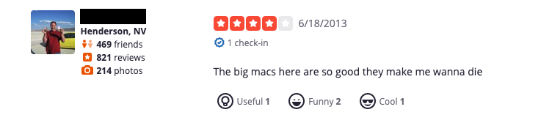
Problems with Word2Vec
Challenges:
Inability to handle out-of-vocabulary (OOV) words
No shared representations at sub-word levels
Languages such as German or Turkish
Scaling to new languages
Word2vec doesn’t understand the full context of the word
Within our project:
Sentiment of a customer’s Yelp review
Social media post: “I had a loooong day! I am soooooo tired!”
“loooong” and “soooooo” not be processed by word2vec
Notes:
BEN
Google it (among other issues, you should mention the problem of fixed embedding)
I am fishing on the bank vs. I am robbing the bank
The two “bank”s have different meaning but same embedding in word2vec system.
Similarly, when to try to analyze the sentiment of something like customers’ review, without considering the context and order of words, the embedding for the two sentences could be similar.
In your presentation, you could directly demonstrate with BERT’s Built-in sentiment analysis function, see how BERT understand the two sentences. See here: https://huggingface.co/transformers/task_summary.html the sentence classfication section/sentiment analysis
“The movie is terrible” vs. “the movie is terribly good”

Slide 16
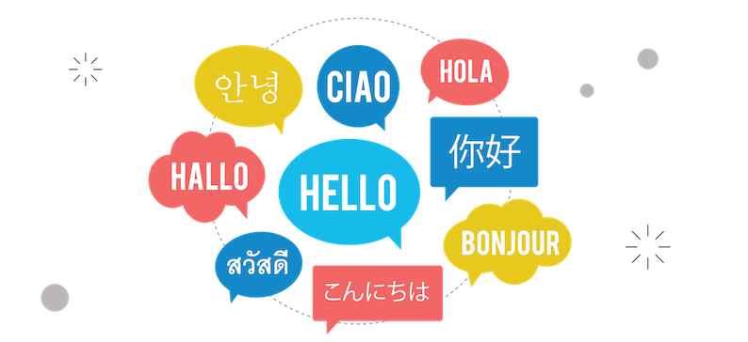

Context Matters
RNN puts the contextual information in hidden state
Attention directs the focus to the right context
RNN uses seq2seq method, which generates an output sequence from an input sequence.
Examples:
Language Translation
Recommendation System
Notes:
Ben: The Word2vec method shows that context of the word is very important. Traditionally, RNN and attention can help handle the context problem. An RNN puts contextual information in hidden states, and attention directs the decoder to the right context. RNN uses the seq2seq method, which generates an output sequence from an input sequence. Some examples of seq2seq are language translation which takes the current language as the input and generates the wanted language translation as the output. Another example is recommendation systems used in business such as airbnb, where it creates an embedding from your preference which is the input and the output is the recommendation to you.
Translation, context generation (business application: marketing content development), recommendation (business application: recommendation system: https://dl.acm.org/doi/10.1145/3219819.3219885 people will be amazed if you could explain to them that a model designed for translation like seq2seq can be used in other area like sophisticated recommendation system)

Slide 17
RNN
Recurrent Neural Network
A hidden state layer that maintains the contextual information
Output Layer
Output
Output
Output
Output
Output
Output
3
2
3
Hidden State Layer for Contextual Info
Context
Context
Context
Context
Context
Context
1
Word
Embedding Input
We
learned
NLP
in
Summer
1
Notes:
Elisabeth Webb:
The defining character of a recurrent neural network is that there is a hidden layer that contains the contextual information. At each step, such as shown in the dashed box, the raw information in blue and previous contextual information labeled as 2 is combined. The new contextual information is either used to predict the output or is passed to the next step. The hidden layer allows the algorithm to access to the previous contextual information and update it with new context meaning. By passing the context along it is similar to how humans read by keeping context in mind. Although, a problem with RNNs is that they are sequential, so only the last hidden state is passed to the next one. This is an issue, because the information in the last hidden state is likely dominated by the last few words which could misinterpret the context of the word because it’s not seeing the whole sentence. This is why need attention mechanism to direct the decoder to the most relevant context.
-----------------
Seq2Seq is just two RNN models connected to each other, with the first being an encoder and the second a decoder. The last hidden state of the first RNN is passed to the second RNN as the input.However, a problem with the RNN, is when performing backpropagation, the gradients need to be multiplied again and again to update the weights. This can lead to either a very large or very small number, and both are not good.

Slide 18
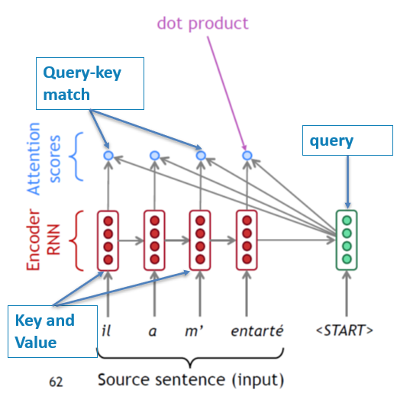
Attention Mechanism: Query--Key--Value
Seq2seq: encoder RNN + decoder RNN
Attention: Enable each step of the decoder to focus on the most relevant part (hidden state) of the sentence (encoder).
Notes:
Elisabeth Webb: In the sequence to sequence model, there are two RNNs together, with one as the encoder and one as the decoder. Attention takes each step of the decoder and enables it to focus on the most important parts or words in the encoder. Attention works using a common mechanism in machine learning called query, key, value match. The query asks a question to find the context which are in the hidden states or the keys. The query goes through each key to see if they are the match or the right context. It does this by calculating the inner products, aggregating the values, and then giving it back to the query. The algorithm can now focus on the most relevant input information. As you can tell from the sequence to sequence RNN with attention is slow and expensive because it stores the contextual information in hidden states that the RNN has to process. This is why we need self-attention to make this process more efficient.
---------------------------------
The image on the right shows that the red is the encoder and the green is the decoder. The query is the hidden state of the decoder, and it asks “where is my context?”. The hidden states in the encoder answers it by saying “I am the context”. Then the query goes through each key to see if they are in fact the match or the right context, and it does this by calculating their inner products. It next puts these inner products, which are the attention scores, in a softmax function and probability distribution. It uses this distribution to calculate a weighted average of the input hidden states, which are the values that give us the attention output. Lastly, it attaches the attention output to the decoder hidden state, so that the most important information is added to the current decoder.

Slide 19
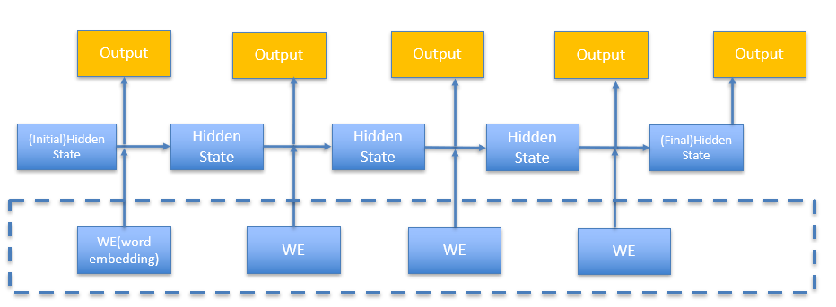
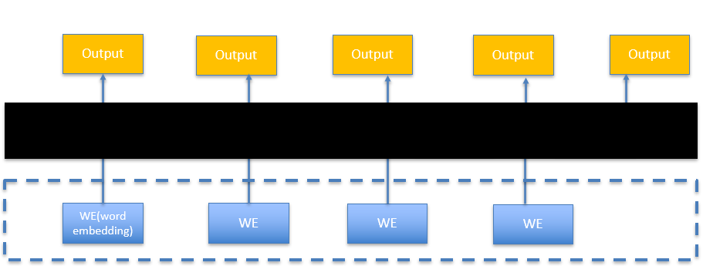
Self-Attention
Self-attention mechanism also uses the query, key, and value, but instead of using hidden states, it puts the contextualized information in the embedding of each word, thus eliminating the hidden states altogether and solving the inefficiency of seq2seq RNN.
Notes:
Elisabeth Webb: Self attention also uses the same query, key, and value mechanism, but instead of storing the contextual information in hidden states, we put that information directly in the word embedding. This eliminates the hidden states altogether and improves the efficiency of the model. Because contextual information is now stored in the word embedding itself, word embeddings for the same exact word are no longer fixed. The new contextualized embedding of a single word can give us some clues of the context. Next we will show an example of this.
---------------
Attention
http://jalammar.github.io/visualizing-neural-machine-translation-mechanics-of-seq2seq-models-with-attention/
Example that helps you illustrate your points
https://web.stanford.edu/class/cs224n/slides/cs224n-2020-lecture08-nmt.pdf from page 55
Self-Attention and Transformers
http://jalammar.github.io/illustrated-transformer/
Example that helps you illustrate your points
Original paper: https://arxiv.org/abs/1706.03762 [2017]

Slide 20
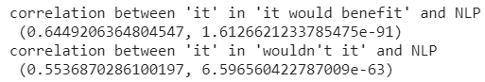
Examples of Self-Attention
Text 1: We learned NLP, from word embedding to transformer, in summer 1. We think it would benefit us a lot in job market, wouldn't it?
The word “it” in “it would benefit” has a higher similarity with NLP than “it” in “wouldn’t it” does. The transformer was able to learn the difference in context.
Text 2: Richard does not like jupyter notebook, because it seems to keep things online, and he wants to have everything locally.
Contextualized embeddings: Input tokens see each other and incorporate information about the other words -> improved efficiency.
Notes:
Elisabeth Webb: The text on the top highlighted in yellow says “We learned NLP, from word embedding to transformer, in summer 1. We think it would benefit us a lot in job market, wouldn't it?” In the sentences, the word “it” has two different meanings. The first means it refers to NLP and the second is just an adverb. We test the model to see if it picks up the difference. The model does capture the different meanings, because the it referring to NLP has a higher correlation to the word than the it that is just an adverb. The model using self-attention was able to understand the different meanings of the word it based on the context. Next we’ll show how self-attention in used in transformer models.
--------------------------------
https://colab.research.google.com/drive/1psrkjscprMdReg_ZMc_czL3HlPvg2U7j?usp=sharing

Slide 21

Transformers
Transformer: Self-attention layers stacked together. Output of each layer as the input of the higher layer.
Encoder: Understanding meanings embedded in text
Decoder: Generating content
Advantages:
Fast computation: no hidden state
Powerful: multi-headed and multi-layers
Many famous NLP models share the same root-transformer/self-attention mechanism.
Notes:
Elisabeth Webb: A transformer is made up of multiple self-attention layers stacked together, and it also has an encoder and decoder part. The encoder is powerful at understanding the meanings and contexts of words, and the decoder part works to generate text. Transformers are powerful models because they are are fast in computation as they have no hidden states, and they use self-attention with many heads with different focuses to evaluate words. This self-attention process with many heads is repeated multiple times with the goal of finding different meanings in the words based on the context. From studying the theory we can understand that many NLP models actually share the same root-transformer and self-attention mechanism. Next we’ll show an example of a transformer-based encoder and decoder.
--------------------------------------------------
The output of the encoding part of a transformer is a new contextualized embedding that then goes to a decoder to perform the specific task such as classification. It adds and normalizes to make the the network more stable in the training process and goes to a feedforward system which is common activation layer where each element in the vector enters into a sigmoid activation function to create some non-linearity.
Find their “logo” and let people know those famous NLP models are actually sharing the same root--transformer/self-attention mechanism (the paper: attention is all you need). And tell people (your future employer too), by (in theory) understanding transformer mechanism and (in practice) doing BERT + downstream ML tasks, we are very advanced in the NLP application. That’s the purpose.
Transformers based NLP model
All transformer-based models: https://huggingface.co/transformers/model_summary.html
BERT
http://jalammar.github.io/illustrated-bert/
https://huggingface.co/transformers/pretrained_models.html
Original paper: https://arxiv.org/abs/1810.04805 [2018]

Slide 22
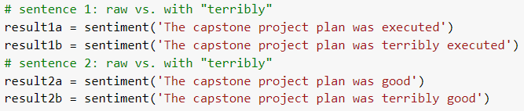
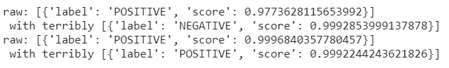
Example: Transformer-based Encoder
Sentiment of “terribly executed” verses “terribly good”.
Notes:
Elisabeth Webb: This is an example of a transformer based encoder. It shows two sentences that both have the word “terribly” in them. One has the phrase “terribly executed” and the other says “terribly good”. When we feed these sentences into the model, we can see from the scores that “terribly executed” was highly negative and “terribly good” was very positive. This shows that when using a more negative word such as “terribly” in front of a more positive word such as “good” it won’t change the sentiment. The encoder has picked up the different meaning of the word based on the context, which is what we want it to do.
--------
Won’t change the terribly good but does change executed terribly.

Slide 23
Example: Transformer-based Decoder
Text generators: GPT-2 (transformer-based decoder)
GPT generates and decodes (mimicking the style)
BERT encodes the understanding
Designed for college graduates with a statistics/quantitative background, such as engineering, science, computer science, economics and/or business, this high-quality, hands-on, comprehensive interdisciplinary Master of Science in Business Analytics program provides individuals with the knowledge, tools, and skills to analyze data to make effective business decisions. In addition, the program empowers students with soft skills needed to manage business analytics projects including problem-framing, teamwork, project management and communication. Courses are held in a face-to-face format in small cohorts of approximately 25 students at the LMU Playa Vista Campus. The program can be taken in one year (fall, spring, and summer semesters) as a full-time program or as a part-time program over two years. This program provides students with the ability to make significant changes to their business analytics projects including changes in the business logic, information analytics, and marketing environment to help their research and development. In addition, this program offers students with the ability to create a business analytics project which provides them with the tools, tools, and skills to develop an impactful business
Notes:
Elisabeth Webb: This is an example of a transformer-based decoder model called GPT-2 which a text generator that was published earlier this year. The first half of paragraph below was copied from LMU’s website and it is the description of the MSBA program, and the second half of the paragraph that is highlighted in blue is what has been generated by the model. When comparing the paragraphs you can see that the model was able to mimic the writing style of the original paragraph and maintain mostly correct grammar. This show how a powerful transformer based decoder model can be used for content development such as in marketing. Lastly, I’ll go over some real-life applications of NLP that we’ve learned.
-------------------------------------
It reads: “Designed for college graduates with a statistics/quantitative background, such as engineering, science, computer science, economics and/or business, this high-quality, hands-on, comprehensive interdisciplinary Master of Science in Business Analytics program provides individuals with the knowledge, tools, and skills to analyze data to make effective business decisions. In addition, the program empowers students with soft skills needed to manage business analytics projects including problem-framing, teamwork, project management and communication. Courses are held in a face-to-face format in small cohorts of approximately 25 students at the LMU Playa Vista Campus. The program can be taken in one year (fall, spring, and summer semesters) as a full-time program or as a part-time program over two years.” The second half of the paragraph that is highlighted in blue is what has been generated by the model. It reads: This program provides students with the ability to make significant changes to their business analytics projects including changes in the business logic, information analytics, and marketing environment to help their research and development. In addition, this program offers students with the ability to create a business analytics project which provides them with the tools, tools, and skills to develop an impactful business”. Although it is a vanilla version of the model it does have correct grammar and maintains the writing style of the original paragraph. This show how a powerful transformer based decoder model can be used for content development such as in marketing. Lastly, I’ll go over some real-life applications of NLP that we’ve learned.
--------------------
https://transformer.huggingface.co/doc/distil-gpt2
https://gpt2.ai-demo.xyz/

Slide 24



Real-life Applications
Common Uses of NLP:
In-domain Application
Language Translation
Google Translate
Word Processors
Microsoft Word or Grammarly
Personal Assistant Applications
Google Home, Siri, Alexa
Consumer Sentiment Analysis
Analyzing Yelp reviews
“Out-domain” Application
Recommendation Systems
Airbnb preferences
Image Generation
Notes:
Elisabeth Webb: NLP can be used for a variety of tasks. Some common uses that we have learned in summer 1 are language translation such as google translate, word processors such as microsoft word, personal assistant applications such as Siri or Alexa, or sentiment analysis including analyzing consumer reviews on Yelp or Amazon such as in our capstone project. Some out of our domain application are some types of recommendation systems such as the company Airbnb. They take each listing you browse and represent it with a vector (similar to how a word is represented by a vector in NLP). By observing your browsing behavior, Airbnb has collected a sequence of listings that you checked similar to the input sequence of text in NLP seq2seq model. The output is just the recommendation to you. Another out of domain application is image generation which works in the same way NLP does where it takes the image as a vector embedding and outputs the prediction of completing the image. When looking at the photos it generated you can tell that they do match the style of the input image. Now I will hand it off to my teammates Eric, Carla, and Vincent to discuss the implementation and demonstration of our in learning in summer 1.
Marketing content development: JD.com uses NLP to generate text descriptions (50% of their descriptions on the website are generated by AI) and they found that the machine generated content resulted in better sales performance.
Recommendation Systems: Airbnb uses embedding and seq2seq model

Slide 25

Implementation
& Demonstration

Slide 26
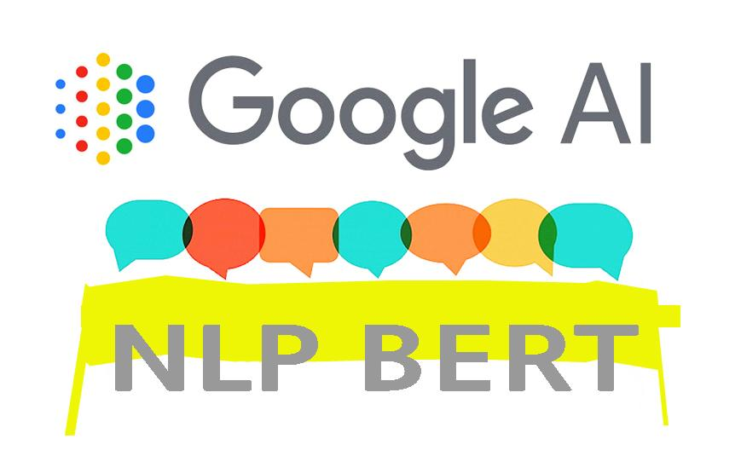
Takeaways from Summer One
Knowing how to utilize BERT and combining it with various downstream machine learning tasks. (ex. Apply a “BERT + NN” structure to YELP or Amazon reviews)
Practicing to tune the model hyper-parameters for better performance (e.g., Set up different learning rate, optimizers, batch size, etc.)
Notes:
Eric
Lr = 3 e-05 0.00003 → 4 epochs → model learned nothing
10 e -05, adam → 8 epcheh

Slide 27

BERT Structure

Slide 28
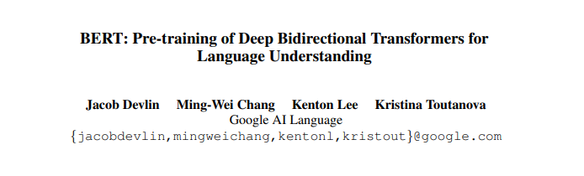
BERT
Encoding machine based-on transformer
Raw inputs (words/sentences) → contextualized numerical representation
Contextual information and interdepencies encoded into embedding
Applications
Contextualized embeddings -> downstream ML tasks like classification and cluster
Advantages:
Trained on large corpus → transferable
Many heads at each layer
Many layers to repeat the process
Notes:
Eric Wu: BERT is the encoding system of the transformer that was trained on wikipedia and many books. It’s powerful at taking raw inputs of words and converting them into contextualized numerical vectors using the self-attention mechanism that can then be used for downstream ML tasks such as classification, prediction, and text generation. BERT is powerful because it is trained on a large corpus of words and the embeddings used to represent words are 768 in length. It has many heads that are the brains that read the word with a different focus on find multiple meanings, and then many layers to repeat this process.
ImageNet is the first image dataset with labels, with which training computer vision models and transfer the models to other context are possible. For BERT, it is trained on Wikipedia and many books, and it can be transferred to other language processing context.
Transformers/BERT can generate contextualized embeddings Check the interactive visualization of attention:
https://colab.research.google.com/github/tensorflow/tensor2tensor/blob/master/tensor2tensor/notebooks/hello_t2t.ipynb#scrollTo=OJKU36QAfqOC

Slide 29
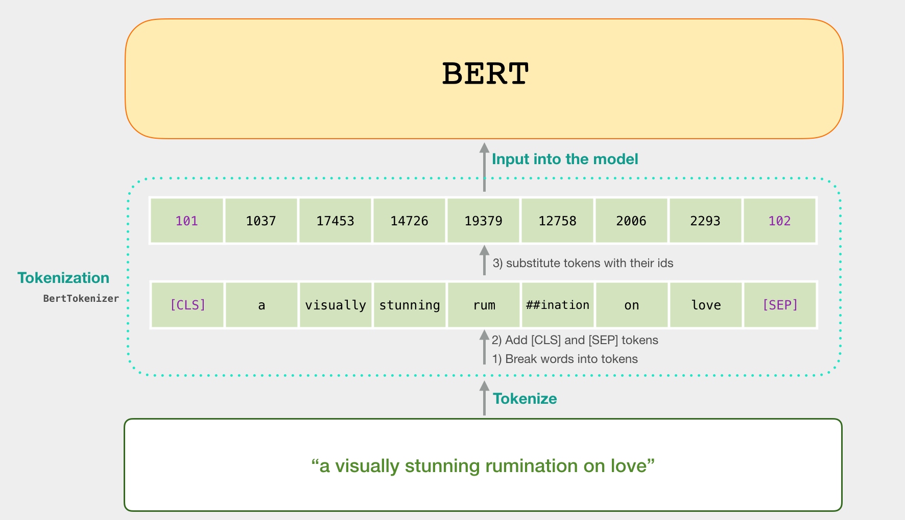
BERT Tokenizer: How to Handle OOV Words
http://jalammar.github.io/a-visual-guide-to-using-bert-for-the-first-time/
Notes:
Eric

Slide 30
BERT Tokenizer
Example sentence:
We learned NLP, from word embedding to transformer, in summer 1. We think it would benefit us a lot in job market, wouldn't it?
Notes:
Eric
for oov → meaningful token → so that the model can capture its meaning

Slide 31
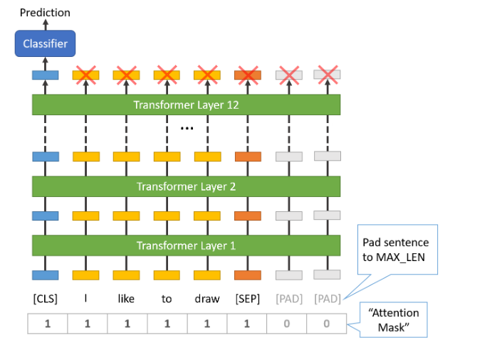
BERT Model
BERT in Numbers:
Base: 12 self-attention layer, 12 heads, word-embedding length: 768
Large: 24 self-attention layer, 16 heads, word-embedding length: 1024
https://mccormickml.com/2019/07/22/BERT-fine-tuning/#41-bertforsequenceclassification

Slide 32
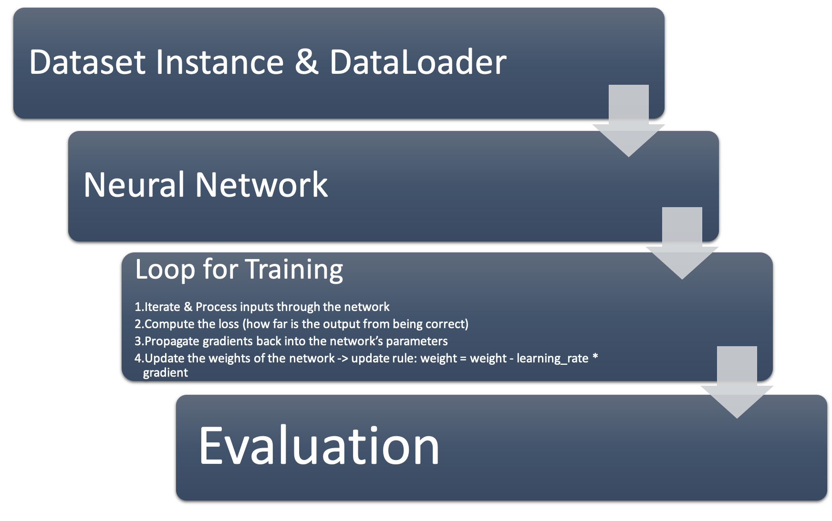

Steps for BERT + NN Implementation
Notes:
Carla
Create an instance of Dataset and Dataloader to pre-process the data before feeding it into a neural network
Create a neural network (using Pytorch)
Define the neural network that has some learnable parameters (or weights)
Set up the loop for training and validating the model
Iterate over a dataset of inputs
Process input through the network
Compute the loss (how far is the output from being correct)
Propagate gradients back into the network’s parameters
Update the weights of the network, typically using a simple update rule: weight = weight - learning_rate * gradient

Slide 33
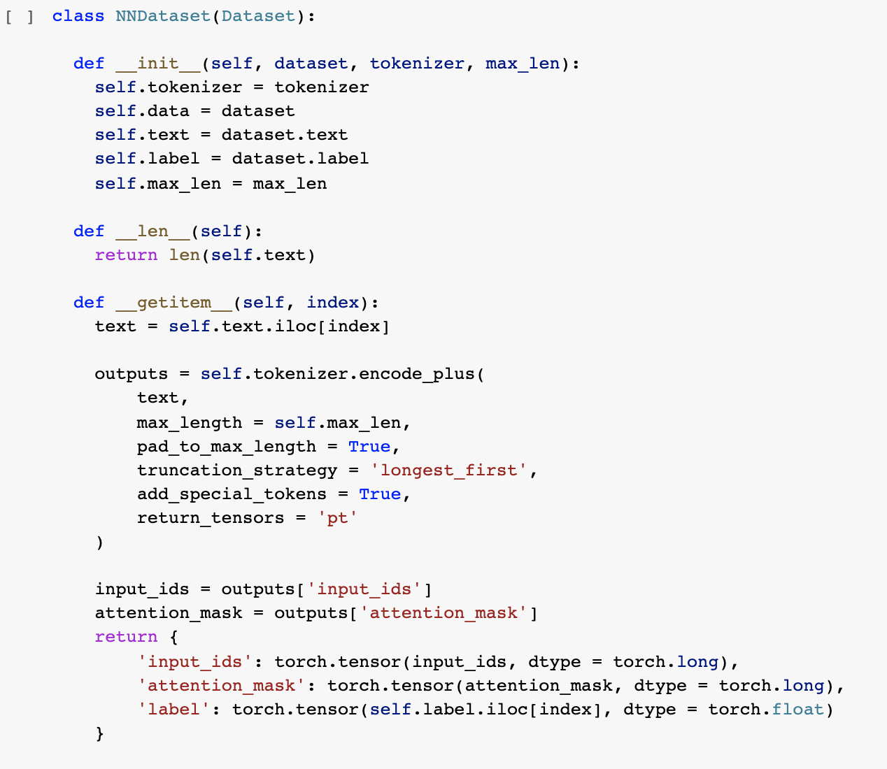
1.Dataset Instance
Inherit Dataset Class, which would take raw data as in input and transform it into BERT’s required input.
__init__ method help us define the raw dataset.
__len__ method help us calculate the max length’s sentence and utilize it as the value for padding/truncating.
__getitem__ extracts each sentence in the text and applies the encode_plus function to preprocess the data and get the input_ids that is necessary for BERT.
Conversion of outputs into tensors.
Notes:
Carla

Slide 34
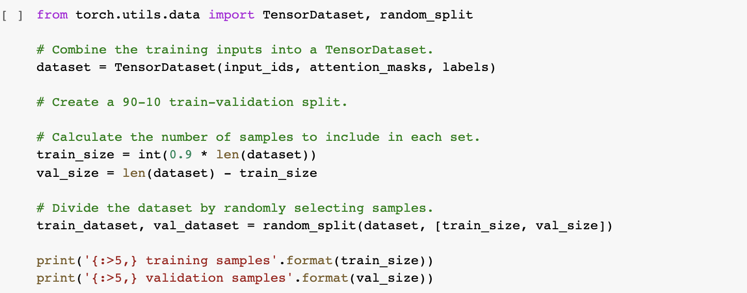
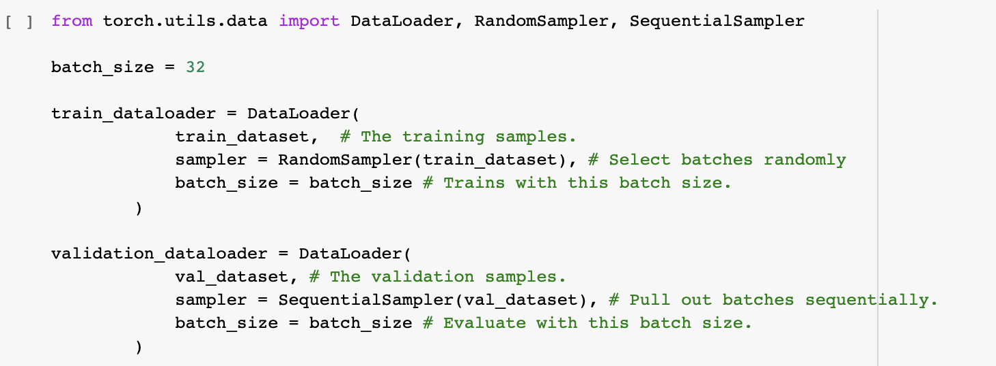
Split Data & DataLoader
Split the data into training and validation set.
Create DataLoaders for both sets.
Batch size.
RandomSampler -> Training
SequentialSampler -> Validation
Notes:
Carla
Cross sample denpency in the our trainoing dataset,

Slide 35
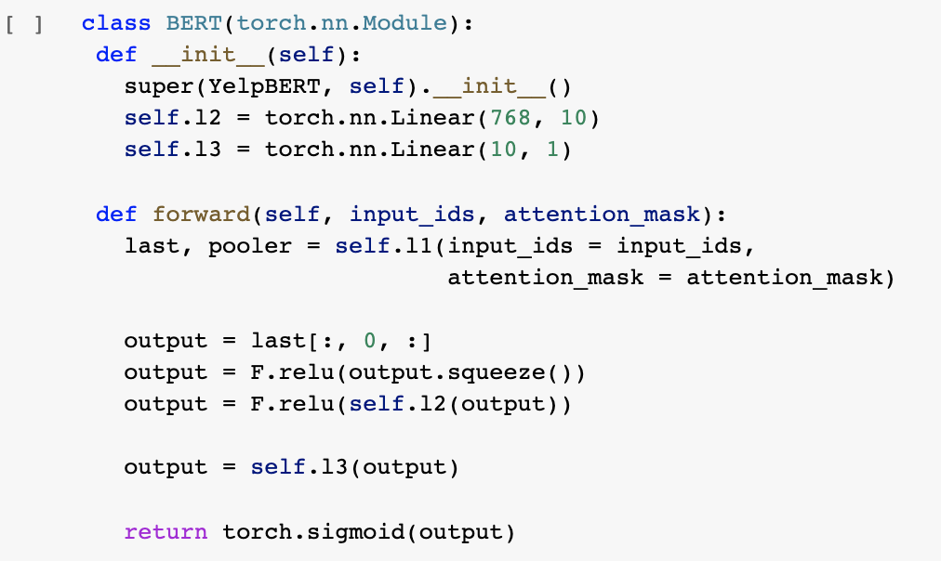
2. Create Neural Network
Inherit the nn.Module class, which provides a base for creation of any NN.
__init__ method defines the type of the layers in the neural network.
Forward method defines how each layer is
connected and which activation function is used.
Notes:
Carla

Slide 36
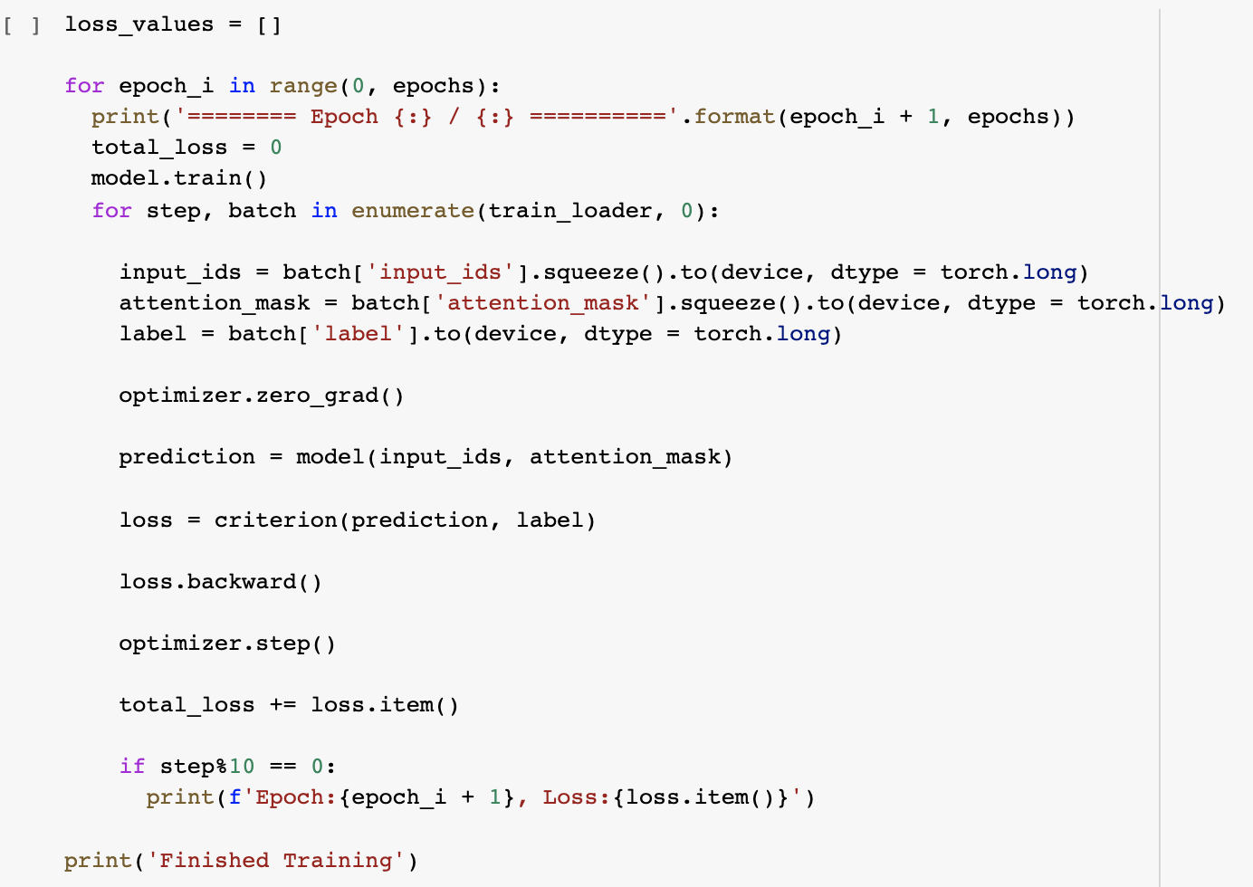
3. Loop for Training Model
Set the Model into “Training Mode”
With the for loop, feed the data from the DataLoader in batches
Feed the data into the GPU
Set the gradients to zero at each step
Compute prediction and loss
Backpropagation
Update weights
Calculate total loss
Notes:
Carla
at each step, before the NN does the feed forward, let's set the gradient to 0
as pytorch nn.Module automatically cumulates gradient from previous rounds
this is good for RNN training, but not necessary for us here. Thus, we turn it off.

Slide 37

Implementation: BERT + NN
Data:
7483 Yelp reviews on restaurants in Bay Area
4000 positive (i.e., star rating 4 or 5)
3483 negative (i.e., star rating 1 or 2)

Slide 38
Implementation: BERT + NN
Experiment 1:
Epochs: 8
Batch size: 32, validation size: 8
Learning rate: adamW, with starting learning rate: 10e-5
Max sentence length: 128
NN Structure:
BERT encoder layer
One fully-connected linear layer (768, 10)
One fully-connected linear layer (10, 1)
Activation function: ReLU

Slide 39
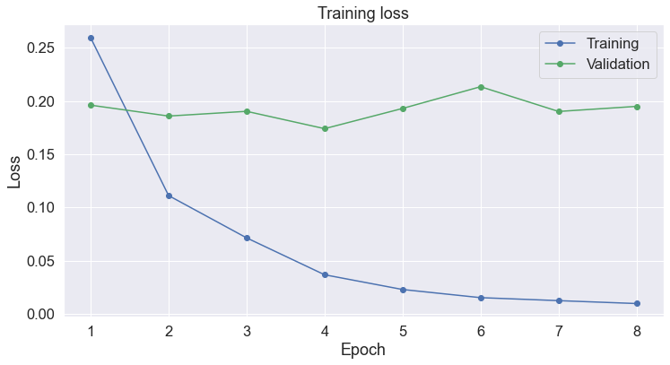
Evaluation of our Model

Slide 40
Overrated Yelp Reviews
Reviews
Rating
Prediction
"Went in to pick up my pizza that I ordered online. It wasn't ready so they told me to wait. 15 mins later the doors swing open and I can see my pizza waiting on the counter. I go up to the front to ask if my pizza was ready the girl in the front forgot that I was waiting for pizza and asked my pick up name again. I don't know how long it was waiting on the back counter for but when I got home the pizza was good however, service was dry"
"A waiter dropped a plate and the power went out... \nAlso they will put stuff in your food that's clearly not on the menu description"
0.006646
0.087540
Notes:
Here are some actual predictions on the Yelp reviews that we have run for the classification task. Look at the first review, the reviewer mentioned that “I don’t know how long ut was waiting on the back counter” but the rating is at four stars, our model makes a prediction at 0.006646, which implies for just one star.
Another typical example is that a waiter dropped a plate and the power went out, but the customer gave a four star rating but our analysis gave a score on 0.087, which means only one star.
Same thing on the third comment, the reviewer expressed some disappointment in the review but his or her star rating is still at four stars, but our model could sense that nagative sentiment and make a more accurate star rating based on the comment.

Slide 41
Underrated Yelp Reviews
Reviews
Rating
Prediction
"My friends and I came here on a Monday evening (with reservations), which you definitely do not need because it was pretty empty around 730pm. \n\nI was excited about coming to eat here because I've heard stories about how good their uni pasta and lobster garlic noodles were. The menu itself sounded really good too. \n\nWe were greeted and seated immediately. The workers were kind and attentive. We ordered:\n1. lobster garlic noodles - okay, not great\n2. uni pasta - very creamy and thick, tasted more like Alfredo\n3. grilled Cajun garlic oysters - similar to a seafood boil and over cooked \n4. fried calamari - really good breading, thin and crunchy\n5. Oyster platter \n6. Brussel sprouts - really good flavor\n\nI wouldn't come back just for the restaurant but if I were in the area, I'd come back mainly for the appetizers and sides instead of the entrees."
Gave it a try. Salad was pretty good. Fried chicken looked delicious but needed a little more flavor and a bit dry, steak with mushrooms wasn't tasty but the next day we used it for burritos and it was good! Mashed potatoes just needed a little more moisture. Portions are awesome!
0.546306
0.996903
Notes:
Our model can not only tell one review is being overrated, but also if it is being underrated. The first comment here read “the workers were kind and attentive, the sprouts are really good flavor” but with a two star rating, our model on the other hand, makes a prediction at 0.54 and thinks the review should be at three star. The second comment mentioned “portions are awesome” but with a two star, but our model can tell it is acutually a five-star review.

Slide 42
Amazon Review
Reviews
Rating
Prediction
"This didn't work to make my video camera start working again but I think there is something more seriously wrong with it and I need to take it in for repair."
0.002030
…...
…...
…...
…...
Good transferable capability
from Yelp to Amazon Reviews
Notes:
VIncent
After testing on the Yelp reviews, we could also test the model on the Amazon reviews. This review mentions that “there is something more seriously wrong with it and I need to take it in for repair” and gave a four star, but our model gives a very low score for noticing the negative sentiment from the review. It implies very good transferable capacity from Yelp to Amazon reviews.

Slide 43
But...Still need to learn more
Sarcastic Reviews
Rating
Prediction
'First of all, it is really fun using this scale! You never know what it will show next. You might loose 5-10 kg within seconds. Everyone using weight watcher programs and such should buy this product! Satisfaction guaranteed.<br /><br />However, if you want an exact measurement of your weight, you should buy a different product. I was stepping on the scale 5 times and I got five different weights within a 15 kg range. Also, trying the scale on different floor materials still initiated the random number generator.<br /><br />Luckily, Amazon took it back for a full refund. I would never buy it again.'
0.994024
Notes:
Vincent
However, the model is not perfect. For example, Sarcastic Reviews. The review says “it is really fun using this scale! You never know what it will show next. You might lose 5-10 kg within seconds. Everyone using weight watcher programs and such should buy this product! Satisfaction guaranteed.” However, this is describing a scale! SO the reviewer said “I was stepping on the scale 5 times and I got five different weights within a 15 kg range”. This is a typical Sarcastic Review, and a lower rating is expected. However, our model predicts a score on 0.99 for five stars. It means that our model still needs to learn more to sense the Sarcastic meaning from the reviews.

Slide 44
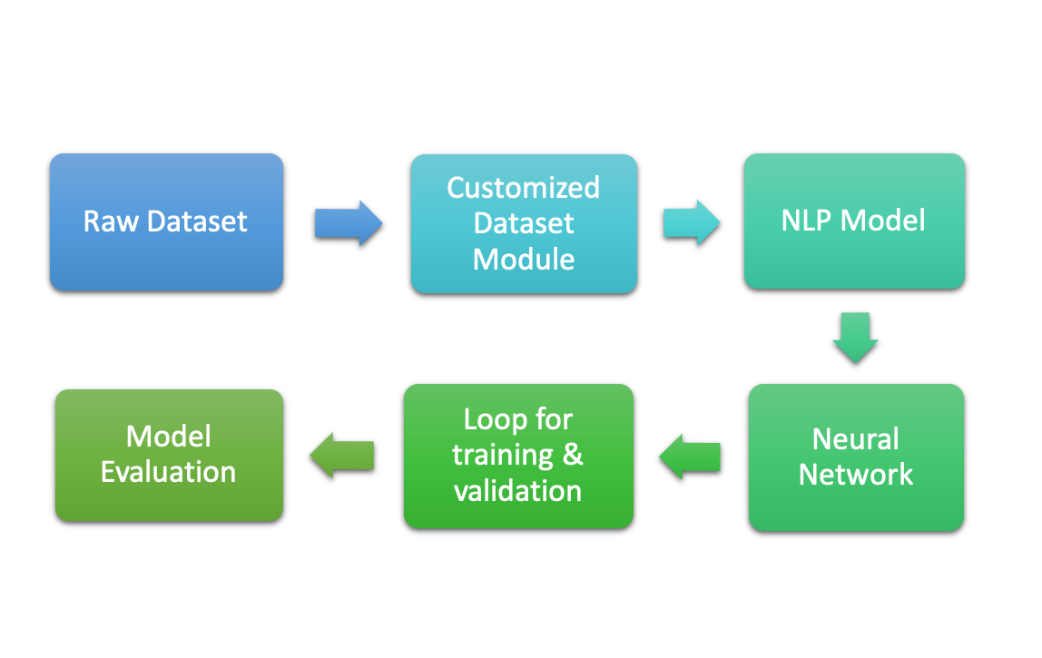
Recap: Implementation Process
Notes:
Vincent
In summary, here is what would do in the implementation process. First we would have a raw dataset, in our case it would be the reviews from Amazon or Yelp. Then we would customize the data to what we need for our analysis, which is the BERT word embedding system. We would next input those customized data into the Neural Network for classification or clustering tasks. In order to get a better result for our model, we would run a loop to train the model to minimize the loss generated by the model by updating the gradient. Last but not least, we would evaluate the training results and make business interpretations based on the result.
Change to NLP Model

Slide 45
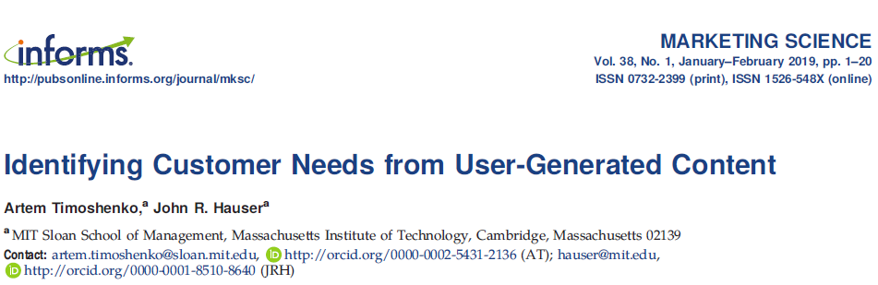
BERT for clustering
Notes:
Except for classification, we could also run clustering with BERT. There is a similar research on the reviews online by MIT, who used clustering for their analysis with convolutional neural network. The big difference between our researches is that they didn’t use BERT for the natural language processing, but just a skip-gram model, which we mentioned before. Other than that, our research methods could be very similar. Due to the time issue, we don’t have a good demonstration of results, yet. Let’s just see what they did at the next slide.

Slide 46
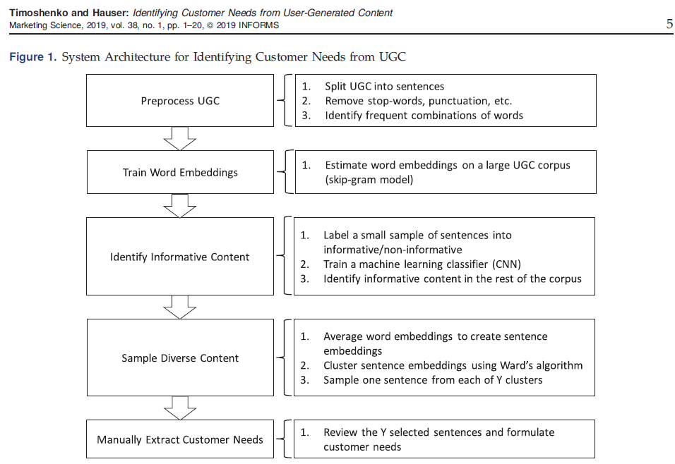
Notes:
Here is a chart directly from their paper. Similarly, they would split the user-generated contents to sentences, remove the stop-words, punctuations for preprocessing. Next, they used a skip-gram model to train word embeddings. They then label some of the sentences as informative or non-informative to train a CNN classifier to identify the rest of the sentences. Other than the classifier, they also cluster and sample the sentences after averaging the sentence embeddings to extract customer needs and mannually review and formulate their findings in the end. Their research is very similar to the RPA project.

Slide 47
Business Applications of Our Models/Methods
“In-domain” Application
Consumer Sentiment Analysis
Customized Attributes Analysis
NLP + Classification Analysis
E.g., Various customer values and focuses in purchasing process
Consumer Opinion Extraction
NLP + Cluster Analysis
“Out-domain” Application
Recommendation Systems
E.g., Airbnb’s example
Notes:
Here are just some applications we have mentioned before as a reminder. Some in-domain applications include language translation, word processors, consumer sentiment analysis. NLP can also be used in recommendation systems and image generation. Then our mentor, Richard is going to talk about the structure of our program. Thank you.
Elisabeth Webb: Some common uses of NLP that we have learned are language translation such as google translate, word processors such as microsoft word, personal assistant applications such as siri or alexa, or sentiment analysis such an analyzing consumer yelp reviews. Some out of our domain application is some types of recommendation systems such as airbnb where each listing you browse is represented by a vector (like a word is represented by a vector in NLP) and by observing your browsing behavior, Airbnb collected a sequence of listings you checked (like the input sequence of text in NLP seq2seq model) and outputs the recommendation to you. Another use is image generation which works in the same way NLP does where it takes the image as a vector embedding and outputs the prediction of completing the image
Marketing content development: JD.com uses NLP to generate text descriptions (50% of their descriptions on the website are generated by AI) and they found that the machine generated content resulted in better sales performance.
Recommendation Systems: Airbnb uses embedding and seq2seq model

Slide 48

Data Preparation

Slide 49

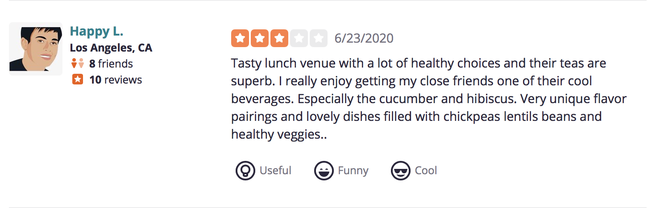
Data Preparation
Data Collection
RPA:
Data collection
Past Amazon Reviews [Public available]
Current Amazon Reviews
RMDS:
National Establishment Time Series (NETS)
Establishment location and industry codes
Past Yelp Reviews [Public Available]
Notes:
Let the audience we are not only preparing the technical part of the capstone projects, we are also working on the data collection (e.g., learning scrapy) and preparation (e.g., coding the raw review data)
Learn scrapy
RPA: coding the review
Describe the process: how we work with RPA and in team to code the reviews and ensure the quality and consistency.
A little about the procedure: burn-in stage → consistency ---> internal validity → reliability
RMDS: collecting the establishment location data and SIC codes
For NETS data: we can just say its name and what info it has, that’s enough for now. If audience ask details, I will handle those questions.

Slide 50
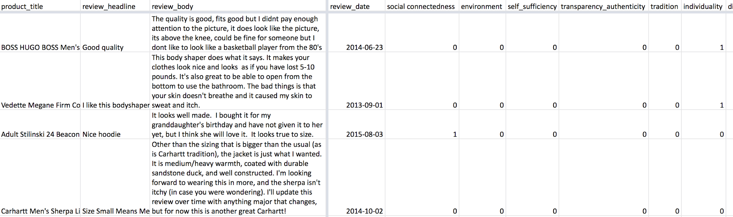
RPA: Coding Amazon Reviews
. . .
Categories: Apparel, Electronics, Health and Personal Care, Home Improvement, and Software
Values: Social Connectedness, Environment, Self-sufficiency, Transparency/Authenticity, Tradition, Individuality, Diversity/Equality, Privacy, Status, Thrift/Value, Innovation, Fun/Adventure, and Health

Slide 51

What’s Next...

Slide 52

Tasks to be completed
RPA
Finish manually coding reviews
Collecting Amazon data
Implement NLP model
Time Series Analysis
RMDS
Calculate co-location index
Manual coding of Yelp reviews
NLP model
Integrate results

Slide 53
The “Value-Chain” of NLP-based Data Analytics
NLP
Data Integration
Econometrics/ML
User-generated-content
Customized Attributes of Interests
Customer and Market Intelligence
Insights from Structured Data
Traditional structured Data
(manual or automatic)
Coding
Outcome
Method
Data / Metrics
Notes:
Data collection on user-generated content (UGC) and on location of business establishment are done
Regrading method: the model and code to extract customer preference from UGC is done, but still lacks of manual coding on those preference
To an abstract level, in the summer (both 1 and 2): complete a NLP -based data analytics (work-flow) in which we have methds, skills to do both textual data and stucutered data.

Slide 54
Thank You!
Q & A!

Slide 55
Backup Slides Here

Slide 56
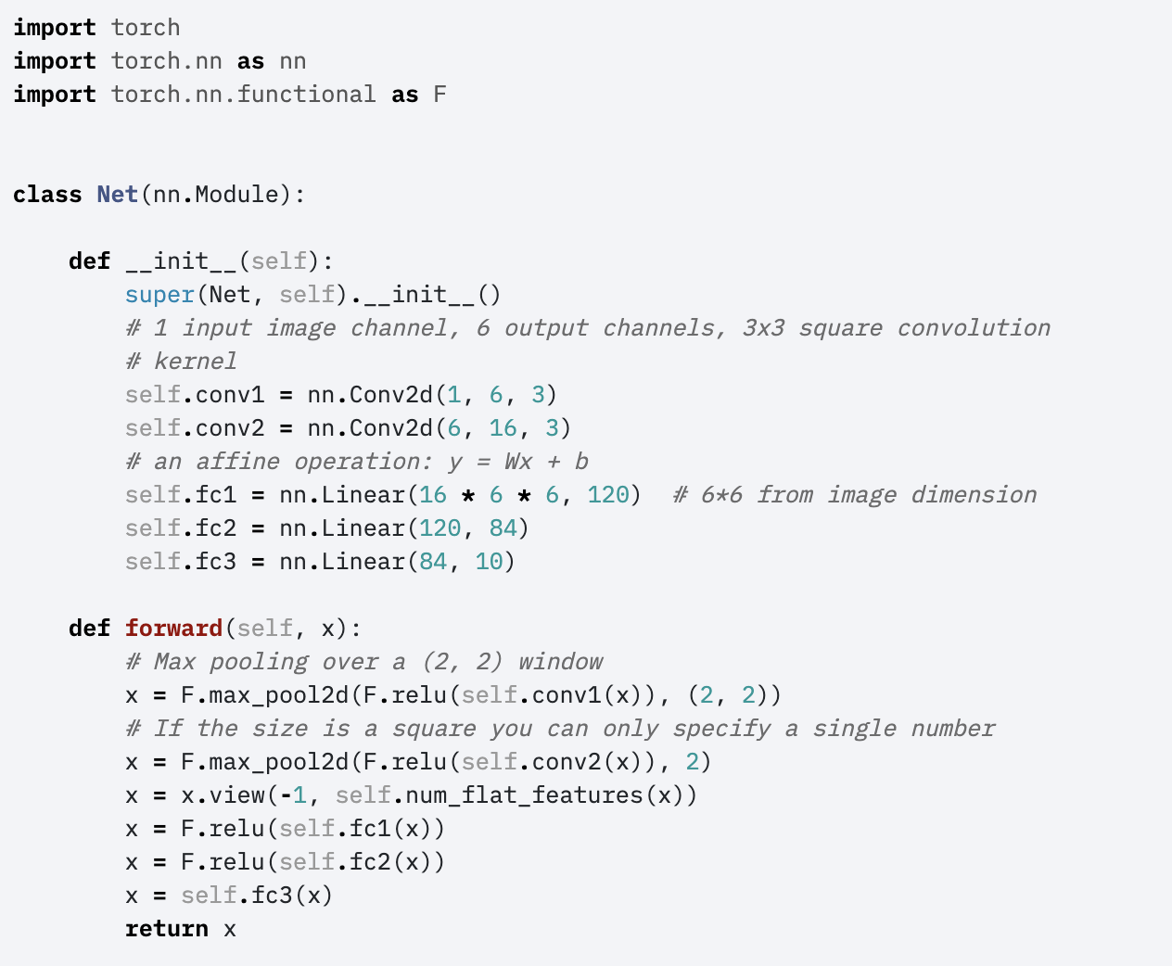
2. Create Neural Network
Inherit the nn.Module class, which provides a base for creation of any NN.
__init__ method defines the type of the layers in the neural network.
Forward method defines how each layer is
connected and which activation function is used.
Notes:
Carla

Slide 57
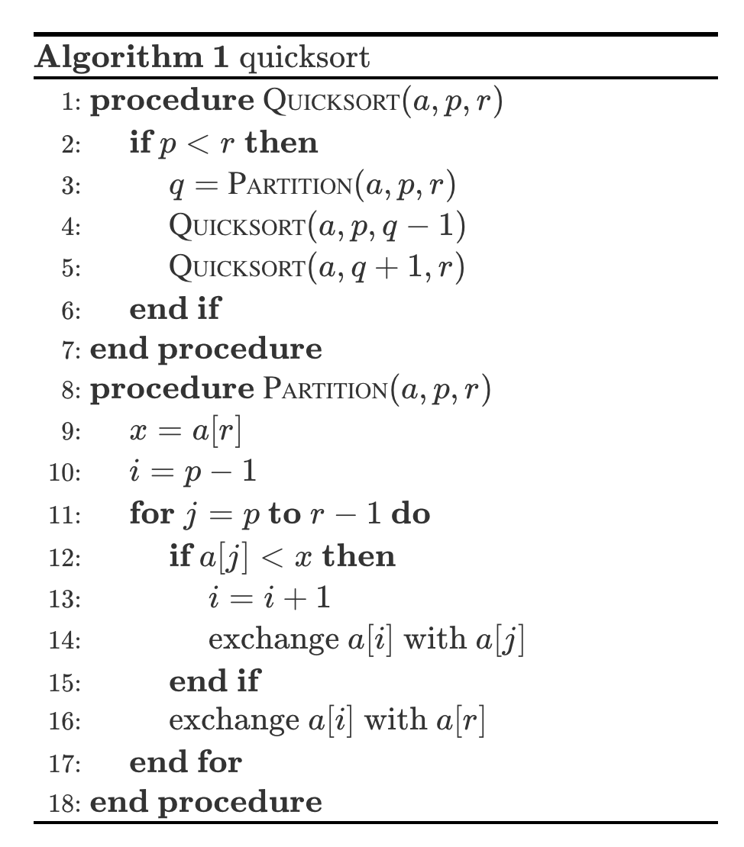
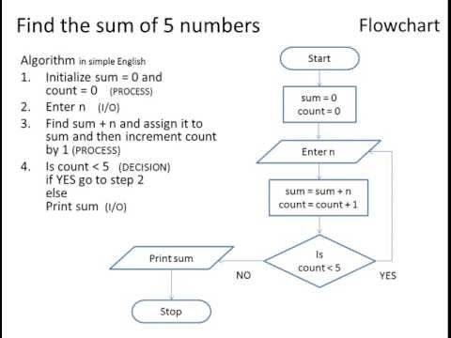
Pseudo code to illustrate the program structure

Slide 58
For demonstration:
Talk about the big picture first
Think about how to visualize the process of “inject” a BERT layer into a NN
How to visualize the structure of NN and the training process
E.g., a customized dataset object preprocess raw input
A dataloader fetch the raw input from the customized dataset and feed into a NN
A loop process train and valid the NN (preventing overfitting)
Trained model is applied to do testing, etc.
Both: tech → what we can do now; implication→ where and how to use it → echo the teamates’

Slide 59
Agenda
Openning: (what we have learned in summer I)
NLP (encoding text to numbers) → downstream tasks
How the learning outcome related to your capstone project
Values of the skills (recall the marketing science paper): automatically extract useful info from huge amount of customer generated content.--> marketing campaign, new product development, sales reps training, customer sentiment, etc.
Theory of NLP (Theory Preparation)
Embedding → word2vec(skip-gram / CBOW) → context matter → attention → self-attention → transformer → BERT
Implementation Demonstration (Coding Preparation)
BERT for classification → variants: size of classification NN: single classification layers vs. multiple classification layers; what to feed in the NN: CLS token vs. average of tokens in the sentences
(optional) BERT + clustering
Comparing the performance of each variant
Data Preparation
Scrapy
RMDS: NEST data (Richard got it)
PRA: manually coding the reviews is started

Slide 60
Task Division
Opening and Data Preparation:
Elizabeth Hyde
Theory of NLP:
Benjamin and Elisabeth Webb
Implementation Demonstration:
Carla, Eric, Vincent

Slide 61
RMDS Data
National Establishment Time-Series Database
Longitudinal database (1990-2010)
44.2 million business, non-profit and government establishments
Location
SIC
Address
Coordinates
Notes:
Notes:

Slide 62
RPA Project
How does uncertainty influence consumers pursuit of different values?
Solution: NLP on customer generated content
NLP Technical Preparation
Data Collection: Historical and Current
NLP + Downstream ML tasks
Notes:
NLP (Bert) + Downstream ML tasks (Multilabel classification)

Slide 63
Summary of Learning Objectives
Data Scraping
Natural Language Processing
Word Embeddings
Neural Networks: CNN and RNN
Attention, Self-Attention, Transformers, BERT
ML Tasks: Clustering and Classification
Coding: BERT + NN
Notes:
Word embeddings → encoding text to numbers
Theory, design and implementation of neural networks, specifically CNN and RNN (LSTM)

Slide 64
Theory of NLP

Slide 65
Milestones of NLP
Neural Language Models
Used in speech recognition, machine translation, handwriting recognition, and other applications.
Attention
One of the core innovations in Neural Machine Translation. Useful for any task that requires making decisions based on certain parts of the input.
2013
2018
2001
2015
Word2Vec(Paper)
Trained vector representations of words. Two different architectures include continuous bag-of-words (CBOW) and skip-gram. Semantic meaning is embedded in the vector representations
BERT models
Bidirectional Encoder Representations from Transformers. Key innovation is applying bidirectional training of Transformer to language modeling.
Notes:
Ben
Generate a milestones of modern NLP: from word2vec (2013)to self-attention (2018) to BERT (2018), this three elements are enough

